Slide 1

V- MODEL: VERIFICATION & VALIDATION MODEL
Presented By: Akshay Ashok, Rithvik Bhat, Jahnavi B, Nomit Vyas and Lakshay Bhati
Presented To: Sunil Nagaraj

Slide 2
INTRODUCTION AND FEATURES
Introduced by Barry W. Boehm in 1979 to emphasize the importance of verification and validation.
It is an extension of waterfall model.
It is also known as Verification and Validation model.
Testing of the software in V- model is planned parallelly with the corresponding phase of development.
Execution of process happens in a sequential manner in this model.
This is a highly-disciplined model and the next phase starts only after completion of the previous phase.

Slide 3
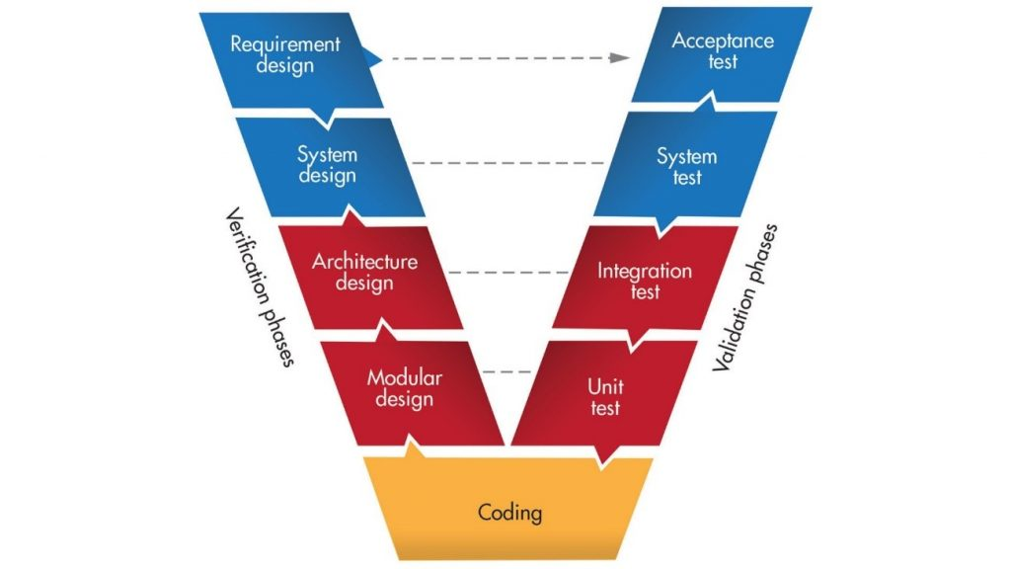

Slide 4
VERIFICATION PHASE
Requirement Design: Detailed communication with customer/client to understand the requirements and expectations.
System Design: Setup of complete hardware and communication equipment required for developing the product
Architecture Design: System design is broken down further into modules taking up different functionality. Also referred to as High Level Design.
Module Design: the detailed internal design for all the system modules is specified, referred to as Low Level Design.

Slide 5
VALIDATION PHASE
Unit Testing: Unit Testing is executed to eliminate bugs at code or unit level.
Integration Testing: Modules are integrated and the system is tested. Integration testing is performed on the Architecture design phase
System Testing: System testing test the complete application with its functionality, inter dependency, and communication. It tests the functional and non-functional requirements of the developed application.
User Acceptance Testing: UAT is performed in a user environment that resembles the production environment. UAT verifies that the delivered system meets user’s requirement and system is ready for use in real world

Slide 6
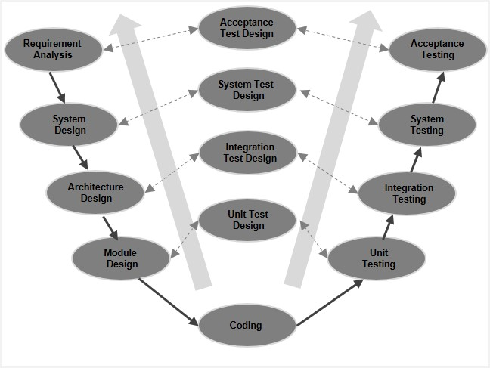

Slide 7
ADVANTAGES
Simple and easy to use.
Testing activities like planning, test designing happens well before coding.
Proactive defect tracking – that is defects are found at early stage.
Avoids the downward flow of the defects.
Works well for small projects where requirements are easily understood.

Slide 8
DISADVANTAGES
The V model is very rigid and hard to execute compared to other software.
The design has limited flexibility in terms of its execution. It is overall not suitable to use for building object-oriented software.
The V Model software is developed during the phase of implementation, so no initial prototypes of the software are produced.
Both test documents and requirement documents require to be updated if there is any fault in the system.
The management of the V model is pretty risky and unstable.

Slide 9
V-Model Application
V- Model application is almost the same as the waterfall model, as both the models are of sequential type
The medical devices industry currently seems to be using the V-Model.
This model is also applicable in military equipment like tank sensors etc.
Tax-related software with respect to the calculations, which is based on laws and regulations.

Slide 10
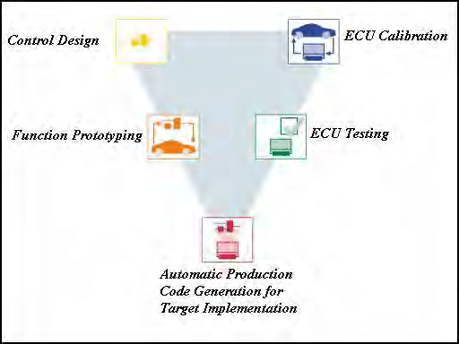

Slide 11
THANK YOU

